Slide 1
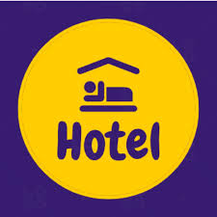
Hotel Reservations
Presented By - RISHI MISHRA

Slide 2
Problem Statement
Hotel Reservation Data from 2017-2018 which helps us to get large volume of data. Including adults and children reservations, car parking and meal type options, number of repeat customers and cancellations.
To create a Excel dashboard to generate insights from the data set. Dashboard is required to organize and visualize data.
To help the management decide for the improvement in the business model. Dashboard should provide insights for growth and management.

Slide 3
Overview
To see the total number of reservation in the last two years and total number of guest accommodated in the hotel.
Understand the reservation made by families with the head count. And track the repeat customers we have had in last couple of years.
Track which market segment has provided the best outcomes and check which month in 2018 was the best for the hotel.
Check the total of special guest have booked and cancelled the stay. Also check the overall cancellation hotel has had and the impact of the cancellation on the meal, room type and parking.

Slide 4
Who will use the dashboard?
Hotel Manager or the management team head.
Business analyst.
Owner of the hotel.

Slide 5
Data Overview
Data Source - Kaggle
Data Size – Rows : 36,725 And Column : 20
Key fields - Booking_ID, Total_Adults, Total_Children, Family, type_of_meal_plan , required_car_parking_space , room_type_reserved , arrival_year , market_segment_type , repeated_guest , no_of_special_requests , booking_status .

Slide 6
Dashboard Design
Pie chart – Total bookings over the years and car parking space
Clustered Column- Cancellation with meal type and total guest accommodate
Clustered Bar- Cancellation with room type, repeat customers and market segment.
Area Chart – Month wise performance of 2018
Stacked Column- Family count

Slide 7
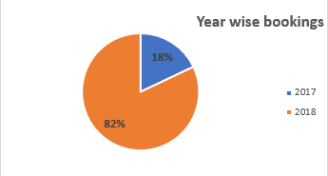
Key Insights
We can see that the majority of the bookings (82%) received is for the year 2018.

Slide 8
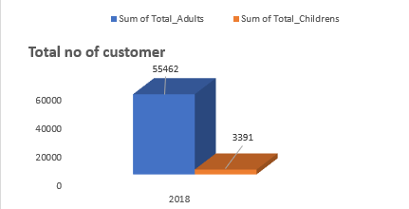
Key Insights
Hotel as accommodated a total of 58,887 guest from which we have shown the count of Adults and Children's.

Slide 9
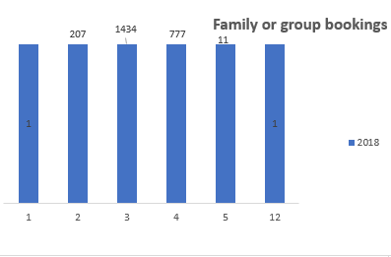

Key Insights
As per the data we see that when we have a family reservation, often the count of guest is between 2 to 5.

Slide 10
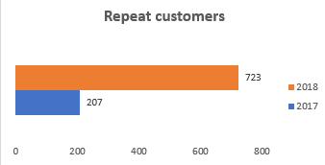

Key Insights
We see that we have a growth in the number of repeat customers.
Repeat customers shows the trust in the brand and helps in engaging more loyal guest.

Slide 11
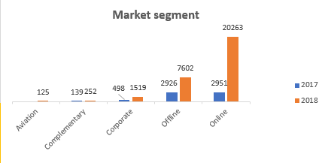

Key Insights
When we talk about the market segment we see that the majority of the attraction has been provided by online and offline segment.

Slide 12
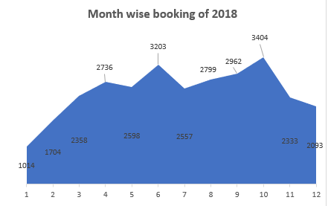

Key Insights
We have seen ups and downs in the year 2018 and we see that the month from April till the end of the year, the reservations number are quite stable.

Slide 13

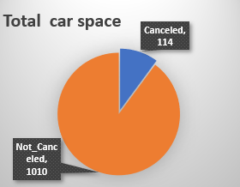
Key Insights
As the reservations was cancelled we see that 10% of the parking space was not utilized .

Slide 14
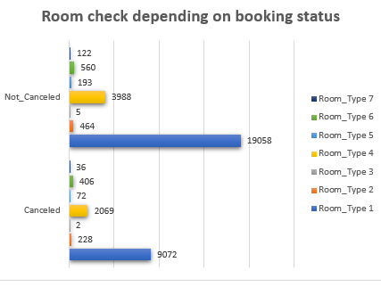

Key Insights
We can check the room availability with the help of the chart.

Slide 15
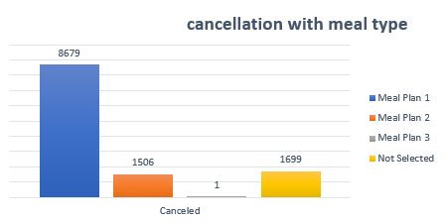

Key Insights
We see that there is a huge impact of reservation cancellation on the meal preparation.

Slide 16
Future Enhancement
We see that there are lot of individuals that are making the bookings, so we need to manage the count of the rooms well and see if we can try to apply bunking system model in the room.
As the majority of the family reservation has members in between 2 to 5, proper room arrangements must be free and price modulation is possible in the segment.
When we see we have a repeat customer reservation, we can offer complimentary supply.
As the response is good from only online and offline segment, we can focus on the remaining 3 segments as well to increase the reservation next year.
We can offer extra discount coupon for the reservation in start of the year(jan,feb,march)

Slide 17
Future Enhancement
If reservation is cancelled and customer has selected a meal type and room type the certain percent will be deducted from the refund amount.

Slide 18
Conclusion
This dashboard will help to monitor the reservation statistics and help the management in the important business decision making. There is lot of scope in growth of the business model and can improve profits. Offers can be provided to the special customer. Room management we will be easy and the future room availability can be check efficiently.

